Slide 1


SHIFT72
Cobalt Consulting

Slide 2
CHALLENGE
Achieving a strategic transition from early segment leader to long-term market dominance
Cobalt Consulting

Slide 3



Sub-Challenges
Strategic
Transition
Distance
Segments
Growth
Cobalt Consulting

Slide 4
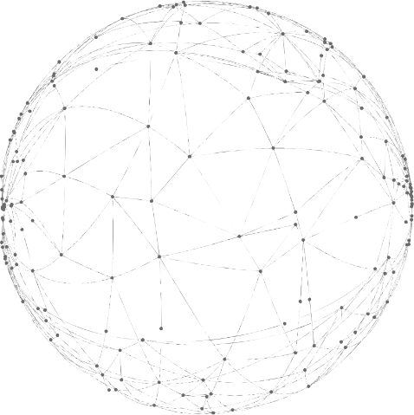
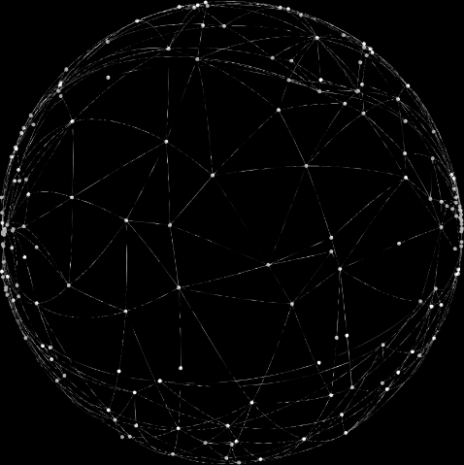
Enter the VOD
ACT I
ACT II
ACT III
Infiltrate
Penetrate
Replicate
Geographical Expansion
Price-Point Expansion
Sub-Industry Expansion
Cobalt Consulting

Slide 5

ACT I: INFILTRATE
Cobalt Consulting

Slide 6
ACT I:
INFILTRATE
Arrange Funding
Lease Offices
Hire Employees
Cobalt Consulting

Slide 7

ACT I: INFILTRATE
Arrange Funding
$5.7 million investment
$3-4 million venture capital
$2 million loan
Cobalt Consulting

Slide 8
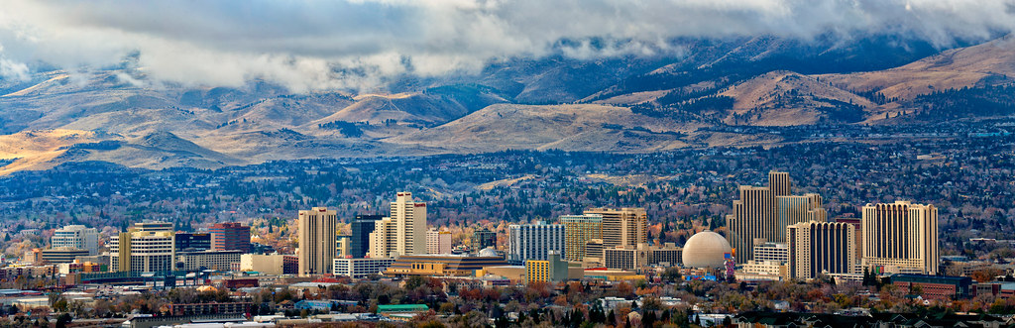
ACT I: INFILTRATE
Lease Offices
Reno, Nevada, United States
Copenhagen, Denmark
Proximity to clients
Cobalt Consulting

Slide 9

ACT I: INFILTRATE
Hire Employees
40 new team members
20 per office
Sourced through HR company
Cobalt Consulting

Slide 10
ACT I:
INFILTRATE
Increases proximity to clients
Mitigates time-zone challenges
Establishes Shift72 on global stage
Cobalt Consulting

Slide 11

ACT II: PENETRATE
Cobalt Consulting

Slide 12
ACT II:
PENETRATE
Analyse
Create Offerings
Advertise
Cobalt Consulting

Slide 13

ACT II: PENETRATE
Analyse
Google Analytics
Identify unmet demands
Key feature and pricing factors
Cobalt Consulting

Slide 14

ACT II: PENETRATE
Create Offerings
Bundle features
Mix upfront and variable fees
Automated low-end platform
Cobalt Consulting

Slide 15

ACT II: PENETRATE
Advertise
Search engine optimisation
Google Ads
$3.5 million annual revenue
Cobalt Consulting

Slide 16
ACT II:
PENETRATE
Increases customer base
Utilises low cost structure
Establishes brand at new price point
Cobalt Consulting

Slide 17
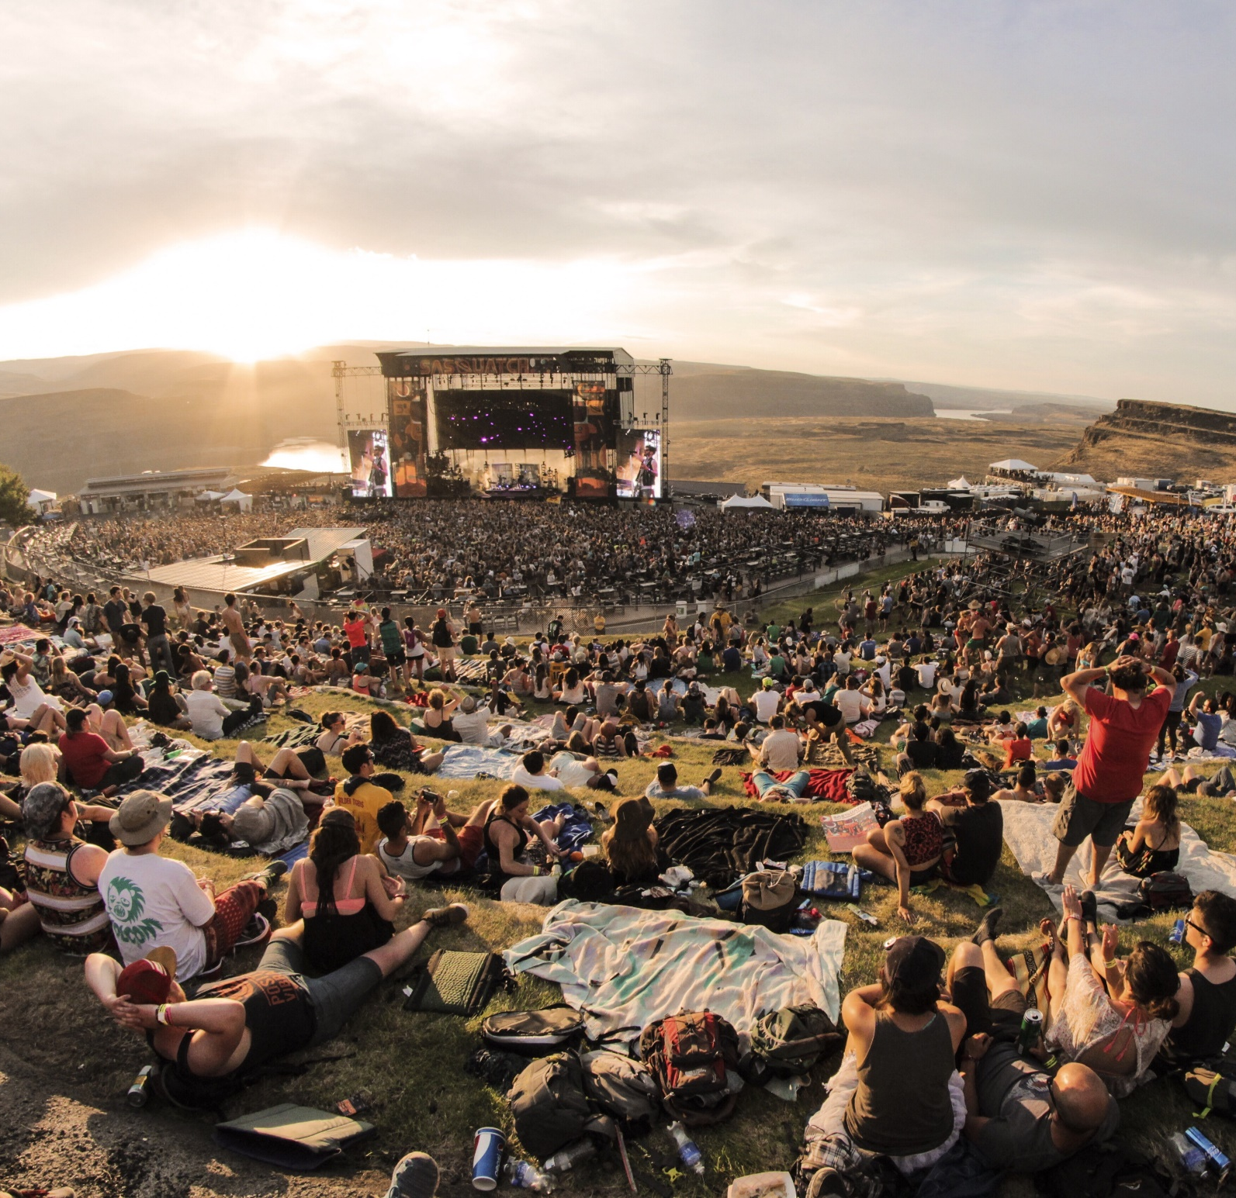
ACT III: REPLICATE
Cobalt Consulting

Slide 18
ACT III:
REPLICATE
Research
Adapt Technology
Advertise
Cobalt Consulting

Slide 19

ACT III: REPLICATE
Research
Technological differences
Industry differences
Key events
Cobalt Consulting

Slide 20

ACT III: REPLICATE
Adapt Technology
$35,000 platform upgrades
High adaptability
Closely related industries
Cobalt Consulting

Slide 21

ACT III: REPLICATE
Advertise
Search engine optimisation
Google Ads
Larger scale for larger market
Cobalt Consulting

Slide 22
ACT III:
REPLICATE
Utilises existing technology
Increases customer base
Diversifies investment risk
Cobalt Consulting

Slide 23
Financial Impact
$5.93M
Investment
$58M
Profit in 2025
Cobalt Consulting

Slide 24
Financial IMPACT
94%
Growth
110%
Increase
2,000
1:9
Forecasted Revenue
New Customers
Addressable Market
Investment:Profit
Cobalt Consulting

Slide 25


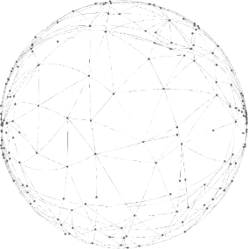
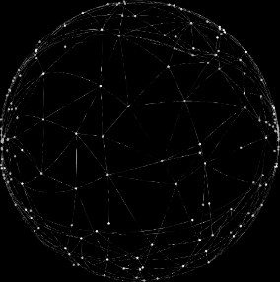
Enter the VOD
Infiltrate
Penetrate
Replicate
Cobalt Consulting

Slide 26
Table of CONTENTS
Introduction
Challenges
Strategy
Timeline
ACT I
ACT II
ACT III
Impact
Risks
ACT I Investment
ACT II Investment
ACT III Investment
Forecasted Income
Forecasted Expenses
Forecasted Profit
Assumptions
Cobalt Consulting

Slide 27
Table of CONTENTS
Location Evaluation
Low-end Market
Employees
Contingencies
ACT II Offerings
Customers
Strategy Timeline
Changes to Revenue
Changes to Expenses
Porter’s Five Forces
Industry Profile
VRIO Analysis
Key Success Factors
Events Market
Risk Mitigation
Alternative Strategy
Cobalt Consulting

Slide 28


ACT II
Example OFFERINGS
Price by Enquiry
$1,500 NZD
$500 NZD
DRM protection
Ticketing and payment portal integration
Limited analytics suite
50 viewers included, $2 each thereafter
Hosting through generic site
Limited DRM protection
500 viewer bandwidth limit
$4 per viewer
Premium DRM protection
Dedicated on-call staff
Personalised platform development
Full analytics suite
Unlimited bandwidth and 4k streaming
Shift Plus
Shift Basic
Shift Premium
Cobalt Consulting

Slide 29
The Customer
ACT II
Global
Festival and cinema companies
Price-sensitive
Demand less features
May be forced into digitilisation
Demand lower upfront fees
Cobalt Consulting

Slide 30
The Customer
ACT III
Global
Tradeshows, concerts, education providers
Early adopters of technology
Seeking value from hybrid events
May be forced into digitalisation
Cobalt Consulting

Slide 31
ACT I INVESTMENT
 | Copenhagen, DEN | Reno, NV, USA | Total
New Offices
Rent | $40,695.97 | $60,056.19 | $100,752.20
New Equipment | $100,842.80 | $100,842.80 | $201,685.60
Utility Costs | $1,746 | $1,746 | $3,492
Internet and Phone | $1,723.20 | $638.76 | $2,361.96
New Employees
Talent Acquisition | $149,814 | $115,248.90 | $265,062.90
New Salaries | $2,158,055.40 | $2,980,646.76 | $5,138,082.16
Total Act I Investment | $2,452,877.37 | $3,259,178.63 | $5,712,056
Cobalt Consulting

Slide 32
ACT II INVESTMENT
 | Estimated Cost
Marketing Campaign
Google Ads | $24,000
Search Engine Optimisation | $19,941.84
Low-end Platform Development | $50,000
Total Act II Investment | $93,941.84
Cobalt Consulting

Slide 33
ACT III INVESTMENT
 | Estimated Cost
Platform Adaptation | $35,000
Marketing Campaign
Google Ads | $50,400
Search Engine Optimisation | $41,876.10
Total Act III Investment | $127,276.10
Cobalt Consulting

Slide 34
Google DIMENSIONS
User Dimensions | Session Dimensions
Demographics | Browse Time
Location | Search Query Patterns
Browsing Behaviour | Visitor Conversion Rates
Device Type | Pages Visited
Channel Sources | Customer Engagement
Cobalt Consulting

Slide 35
Events MARKET
Concerts and Live Events | Current Technology | Capabilities
Mostly live | Pre-produced | Currently in development
Video player | HTML video player | Industry leading
Real-time chat | No chat | Requires development
Filters | Film-specific | Requires adaption
Industry knowledge | Film-specific | Requires learning
Cobalt Consulting

Slide 36
Forecasted INCOME
 | 2021 | 2022 | 2023 | 2024 | 2025
Recurring Revenue | $3,743,142.00 | $4,529,201.82 | $25,120,889.04 | $63,832,179.06 | $77,236,936.66
Project Fees | $691,089.00 | $836,217.69 | $1,011,823.40 | $1,224,306.32 | $1,481,410.65
Total Trading Income | $4,434,232.00 | $5,365,419.51 | $26,132,712.45 | $65,056,485.38 | $78,718,347.31
Cost of Service
Cost of Service | $720,037.00 | $871,344.13 | $4,243,952.50 | $10,565,173.23 | $12,783,859.60
Total Cost of Service | $720,037.00 | $871,344.13 | $4,243,952.50 | $10,565,173.23 | $12,783,859.60
Gross Profit | $3,714,194.00 | $4,494,075.38 | $24,995,332.58 | $62,385,113.20 | $75,485,986.98
Gross Profit % | 84% | 84% | 84% | 84% | 84%
Other Income
Other Income | $464,869.00 | $562,491.49 | $680,614.70 | $823,543.79 | $996,487.99
Total Income | $4,179,063.00 | $5,056,566.87 | $22,569,374.65 | $55,314,855.94 | $66,930,975.69
Cobalt Consulting

Slide 37
Forecasted EXPENSES
 | 2021 | 2022 | 2023 | 2024 | 2025
Administration Expenses | $1,427,854.00 | $1,718,104.95 | $6,747,362.44 | $6,715,092.74 | $6,695,730.93
Research and Development | $2,256,169.00 | $2,256,169.00 | $2,339,125.38 | $2,394,430.56 | $2,256,169.00
Finance Costs | $406.00 | $66,868.00 | $266,254.00 | $266,254.00 | $266,254.00
Total Expenses | $3,684,429.00 | $4,041,141.95 | $9,352,741.82 | $9,375,777.30 | $9,218,156.93
Cobalt Consulting

Slide 38
Forecasted PROFIT
 | 2021 | 2022 | 2023 | 2024 | 2025
Profit/Loss Before Taxation | $494,634.00 | $1,015,424.92 | $13,216,632.83 | $45,939,078.64 | $57,712,821.76
Profit/Loss After Taxation | $494,634.00 | $1,015,424.92 | $13,216,632.83 | $45,939,078.64 | $57,712,821.76
Cobalt Consulting

Slide 39
Changes to REVENUE
 | 2022 | 2023 | 2024 | 2025
Increase in Local Competitiveness |  | 20% growth
Search Engine Optimisation |  | $2,400,000 | $2,400,000 | $2,400,000
Google Ads |  | $1,144,488 | $1,144,488 | $1,144,488
New Price Segment |  | $15,000,000 | $15,000,000 | $15,000,000
New Sub Industry |  |  | 110% growth
Cobalt Consulting

Slide 40
Changes to EXPENSES
 | 2022 | 2023 | 2024 | 2025
Administration Expenses
Talent Acquisition | $265,062.90
New Staff Wages |  | $5,138,082 | $5,138,082 | $5,138,082
New Equipment Depreciation |  | $80,674.24 | $48,404.54 | $29,042.73
Research and Development
New Platform |  | $50,000
Google Ads Act II |  | $14,956.38 | $4,985.46
SEO Act II |  | $18,000 | $6,000
Google Ads Act III |  |  | $41,876.10
SEO Act III |  |  | $50,400
Platform Adaption |  |  | $35,000
Finance Costs
Loan Repayment | $66,462 | $265,848 | $265,848 | $265,848
Cobalt Consulting

Slide 41
ASSUMPTIONS
Assumption | Rate
Industry Compound Annual Growth Rate | 21%
Increase in Local Competitiveness | 20%
Average Monthly Spending on Campaign | $2,000
Average Cost per Acquisition | $20
New Customers | 1200
Average Shift72 Purchase | $2000
Entertainment Industry Average Cost per Click | $0.69
Entertainment Industry Average Conversion Rate | 1.98%
Entertainment Industry Average Monthly Spending on Campaign | $1108
Extra Invested in Campaign | 50%
Cost per Conversion | $34.85
Low-end Market Capture | 5% of competing firms revenue
Diversified Market Capture | 110% larger than current market
Act III Marketing Campaign | Relative to new market size (110%)
Loan Repayments | $2,000,000 at 5.95% p.a. (10 years)
Depreciation on new equipment | 40% D.V. (Technology Industry Average)

Slide 42
Assumptions for INCOME STATEMENT
All figures are in NZD terms and conversions are based $1 USD = $1.44 NZD
Excessive COVID19 growth has slowed to industry CAR of 21% which was used as the base rate of annual revenue increase
Revenue from marketing campaign remains constant after campaign ends despite expected resultant growth (prudent)
All estimates are based on industry averages where possible, otherwise are based on average business of similar size
Growth is shown instantaneously for ease of understanding, growth may occur over a longer period of time
Loan repayments calculated at 5.95% p.a. at $2,000,000 principal over 10 years
Cobalt Consulting

Slide 43
Location EVALUATION
Why Reno, NV, U.S.? | Why Copenhagen, DEN?
Time Zone Solution Relatively low property costs compared to other North American cities. - 71st in terms of price per square metre Film Festival geographic and close proximity to potential and current clients; - Sundance, Utah - SXSW, Texas Close proximity to popular Music Festivals: - Burning Man Festival, Nevada - Electric Daisy Carnival, Las Vegas - Outside Lands, San Francisco - Coachella Valley Music and Arts Festival, California - iHeartRadio Musical Festival, Las Vegas - Stagecoach, California Las Vegas is home to many of the best Trade Shows including; ASD Market Week (B2B trade show), Magic (fashion), AAPEX (auto parts) etc. Trade Shows are also popular in San Francisco. | Time Zone Solution Low general property pricing compared to other central European Nations Proximity to European clients who prefer to connect with local providers One of the highest rates of English-speaking fluency among mainland European nations (87%), therefore assisting with communication between the three branches Proximity to popular Music Festivals; - Tomorrowland, Belgium - Oktoberfest, Munich, Bavaria, Germany Some of the largest Trade Shows in Europe located near Denmark include; Automechanika, InnoTrans, K Fair and ISPO Munich, and are all in Germany. Ease of setting up with excellent support policies. Government provides support to foreign entrepreneurs in exchange for growth. Also, the most digital country in the EU with good infrastructure.

Slide 44
Why the Low-end MARKET?
Increased potential
revenue pool
Diversifies risk of client loss
Generates brand awareness
Low cost
structure advantage
Experience in
low-end markets
Automatable market

Slide 45
Additional Team MEMBERS
Marketing and business focused employment
International teams will collaborate to reduce quantity of new staff
Example: Staff Structure at each new Headquarters
Developers | Business Analysts | Testers | Designers | Marketing-Focus | Sales | Public Relations | Total
5 | 2 | 2 | 3 | 4 | 2 | 2 | 20
Cobalt Consulting

Slide 46
Headquarters' SIZE
Medium sized team of 20 employees
180m²
9m²
Cobalt Consulting

Slide 47

Capital CONTINGENCIES
Increase phase durations
One location at a time
Hire staff at slower rate
Adapt financing structure
Cobalt Consulting

Slide 48
Porter's FIVE FORCES
Supplier Power
Low
Threat of New Entry
Moderate
Competitive
Rivalry Moderate
Threat of Substitutes
Low
Buyer Power
Moderate
Cobalt Consulting

Slide 49
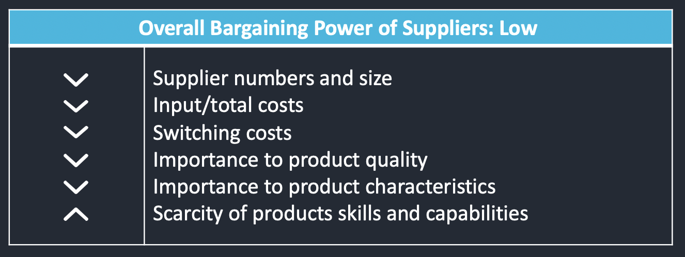

Supplier POWER
Overall Bargaining Power of Suppliers: Low
 | Supplier numbers and size Input/total costs Switching costs Importance to product quality Importance to product characteristics Scarcity of products skills and capabilities
Cobalt Consulting

Slide 50
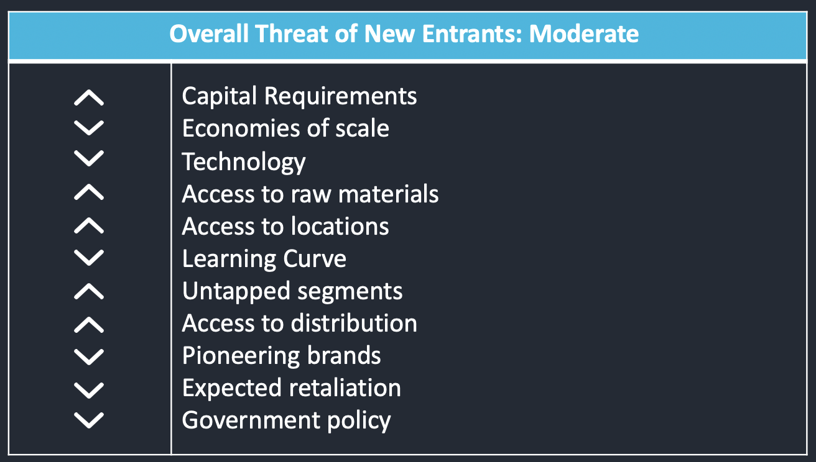
Threat of NEW ENTRANTS
Overall Threat of New Entrants: Moderate
 | Capital Requirements Economies of scale Technology Access to raw materials Access to locations Learning Curve Untapped segments Access to distribution Pioneering brands Expected retaliation Government policy
Cobalt Consulting

Slide 51
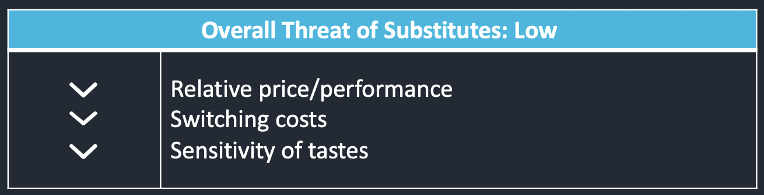
Threat of SUBSTITUES
Overall Threat of Substitutes: Low
 | Relative price/performance Switching costs Sensitivity of tastes
Cobalt Consulting

Slide 52
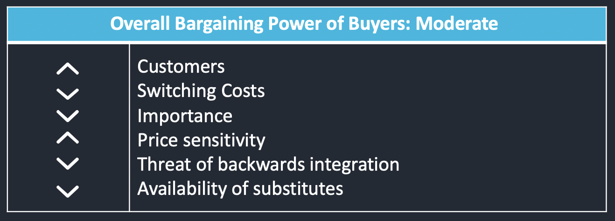
Buyer POWER
Overall Bargaining Power of Buyers: Moderate
 | Customers Switching Costs Importance Price sensitivity Threat of backwards integration Availability of substitutes
Cobalt Consulting

Slide 53
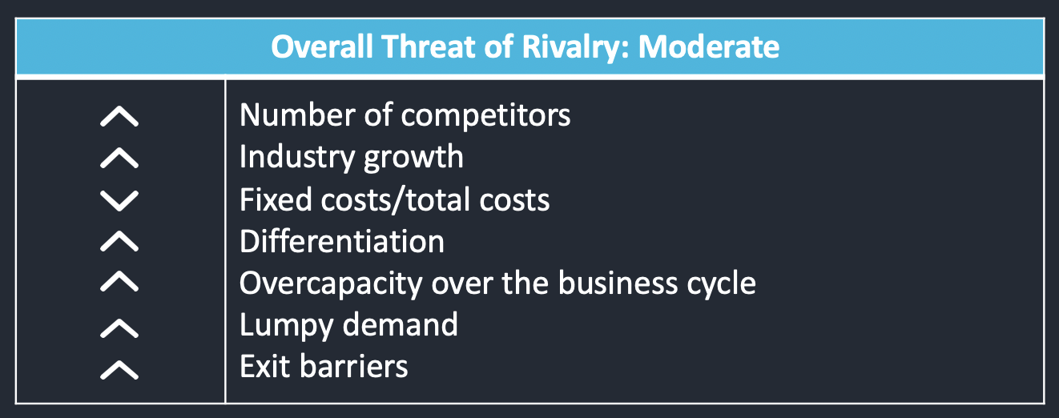
Degree of RIVALRY
Overall Threat of Rivalry: Moderate
 | Number of competitors Industry growth Fixed costs/total costs Differentiation Overcapacity over the business cycle Lumpy demand Exit barriers
Cobalt Consulting

Slide 54
Industry PROFILE
GLOBAL ONLINE VIDEO STREAMING PLATFORM PROVIDER INDUSTRY
Market Size | Currently medium and expected to reach $13.4 billion by 2026.
Market Growth Rate | Currently at a rapid growth rate due to Covid-19 and changing digitalisation trends. Anticipated market growth of 14.4% CAGR during 2020-2026.
Stage in Life Cycle | Growth stage : Continually gaining trust/acceptance among consumers.
Number of companies in the industry | Eventive, Pantafix, Brightcove, Vimeo, Cinesend: There are multiple big players in the market, however, currently Shift72 is the clear market leader in all-in-one festival and cinema VOD platforms, with an unrivalled position in the market.
Scope of Competitive Rivalry | Global.
Customers | Film Festivals, Cinemas, Events & Corporate Market.
Degree of Vertical Integration | High: Companies are creating customised platforms internally within their organisation.
Cobalt Consulting

Slide 55
Industry PROFILE CONT'D
Learning Curve Effects | High: Business, technological, and streaming expertise/ knowledge is essential.
Ease of Entry/Exit | Low to Moderate: Lower capital requirements, however, to become a big player, advanced software and exceptional knowledge is required. Resources can be transferred/sold if required to exit the industry.
Pace of Technological Change | Fast: Hence companies within the industry experiencing continual increase in revenue.
Product Characteristics | Offering the same product (All-In-One Online Streaming Platform) so firms differentiate with their own unique characteristics.
Economies of Scale | Large: Necessary to make high profit.
Capacity Utilisation | Increasing number of festivals, cinemas and events incorporating a digital aspect due to the ongoing uncertainty of Covid-19. An increase in demand means companies within the industry need to utilise capacity effectively.
Capital Requirement | Low to Moderate: No significantly high-cost requirements needed to enter the industry.
OVERALL INDUSTRY PROFITABILTY: HIGH
Cobalt Consulting

Slide 56

VRIO ANALYSIS
Resources & Capabilities | V | R | I | O | CA
Infrastructure Headquarters located in Hamilton CBD |  |  |  |  | CP
HRM 47 Valuable Employees Team-based work conditions. Small self-governed teams usually consist of three developers, a business analyst and a tester Exceptional R&D Team Founder and CEO, David White, is heavily involved with the business operations, originally the only driver of sales |  |  |  |  | CP TCA CP CP
Technology All-In-One platform, providing a complete online streaming solution to clients Ready to sell platform with the ability to customise to client preferences Data Analytics providing information about all users Artificial Intelligence capabilities |  |  |  |  | CP TCA TCA CP
Cobalt Consulting

Slide 57
VRIO ANALYSIS
Resources & Capabilities | V | R | I | O | CA
Procurement APIs acquired from US company, Brightcove Copyright protection provided to all customers |  |  |  |  | CP CP
Operations The first company to create a digital platform with a transition towards a more digitalised world in sight, therefore, the very future focused. Continually adapting to the changing market conditions Automated whole delivery function Multiple innovative product offerings |  |  |  |  | CP CP CP
Inbound Logistics Partnership with Senior V.P of technology at NBC Universal. Potential clients who approach NBCUniversal are then directed to Shift72, therefore gaining more clientele |  |  |  |  | SCA
Outbound Logistics 24-hour rapid delivery of platform Global distribution network |  |  |  |  | SCA CP
Cobalt Consulting

Slide 58

VRIO ANALYSIS
Resources & Capabilities | V | R | I | O | CA
Marketing and Sales Reputation/ Trust Word of mouth marketing due to saving CPH festival overnight Global sales network Market leadership |  |  |  |  | CP CP CP TCA
Service Leading security solutions Reputation for responsiveness Customer Interactions |  |  |  |  | TCA TCA CP
Cobalt Consulting

Slide 59
Key Success
FACTORS
Speed to Market
Adaptability & Responsiveness
Brand Differentiation
Cobalt Consulting

Slide 60
Shift72 PURPOSE
To offer innovative, secure, all-in-one video platforms that assist clients in delivering a viewing experience across multiple devices. Shift72’s end-to-end solution allows customers to build, manage, and grow their online video businesses.
Cobalt Consulting

Slide 61
Strategy aligned with COMPANY PURPOSE
Enter the VOD ensures Shift72 can utilise their existing resources to expand their reach and achieve their purpose with a wider customer base.
Cobalt Consulting

Slide 62
Alternative Strategy
WHAT WE HAVE, WE HOLD
SCENE 1
Use customer data analytics to identify key existing or desired features for current clientele
SCENE 2
Undertake engineering drive to develop key features and technologies to cement leading competitive position
SCENE 3
Build on low cost-structure advantage by acquiring key suppliers such as payment portal integration
Cobalt Consulting

Slide 63
Strategic TIMELINE
Q4 2022
Q1
2023
Q2
2023
Q3
2023
Q4
2023
Q1
2024
Q2
2024
Q3
2024
Q4
2024
ACT I
ACT II
ACT III
Cobalt Consulting

Slide 64
Risk MITIGATION
Revenue
Liquidity
Cannibalisation
Underwhelming Returns
Investment Before Returns
High-end Jeopardization
Cobalt Consulting

